Slide 1
FACIAL RECOGNITION BASED ATTENDANCE SYSTEM
Presented By Under Guidance of
N.HEMANTH Dr.D. Ramesh
S.SAI PAVAN Professor of CSE
MD.REHAN ALI
G.SAI KRISHNA

Slide 2
CONTENTS:
INTRODUCTION
EXISTING SYSTEM
PROJECT DEFINITION
PROPOSED SYSTEM
OBJECTIVES
CONTRIBUTION
APPLICATIONS
CONCLUSION

Slide 3
INTRODUCTION:
Traditionally, student’s attendances are taken manually by using attendance sheet given by the faculty in class, which is a time consuming event.
Moreover, it is very difficult to verify one by one student in a large classroom environment with distributed branches whether the authenticated students are actually responding or not.
FACE RECOGNITION technology is gradually evolving to a universal biometric solution since it requires virtually zero effort from the user end while compared with other biometric options. It is accurate and allows for high enrolment and verification rates.

Slide 4
Types Of Biometrics -
PHYSIOLOGICAL :
BEHAVIORAL :
Finger-scan
Facial Recognition
Iris-scan
Retina-scan
Hand-scan
Voice-scan
Signature-scan
Keystroke-scan

Slide 5
EXISTING SYSTEM:
The existing system is semi-automated that is the attendance is taken manually and being uploaded and then stored in the database.
So, now we aim for fully automated system using image processing technique.

Slide 6
PROJECT DEFINITION:
Our project is face recognition based attendance biometric system which enrolls the unique and permanent facial points and records them .
Once the enrollment is complete, a look at the camera is required to verify the identity and the face recognition attendance system will automatically mark the attendance.

Slide 7
What exactly is Facial Recognition??
A facial recognition is a computer application for automatically identifying or verifying a person from a digital image or a video frame from a video source.
One of the ways to do this is by comparing selected facial features from the image and a facial database.

Slide 8
The implementation of face recognition technology includes the following three stages :
Implementation of Face Recognition:
Image acquisition.
¬
¬
Image processing.
Face image classification and decision making.

Slide 9
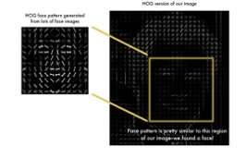
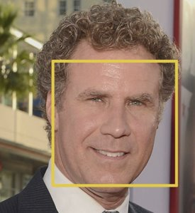
PROPOSED SYSTEM:

Slide 10
Image Acquisition
BLOCK DIAGRAM:-
Image Processing
Extraction of Facial features
Marking the attendance
Comparing with Database

Slide 11
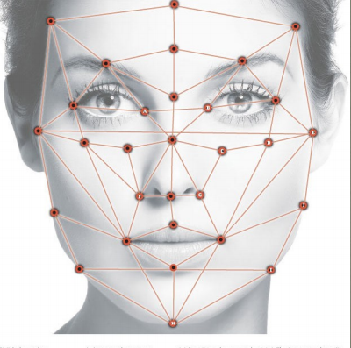
How Facial Recognition System Works
Every face has atleast 80 distinguishable parts called nodal points.

Slide 12
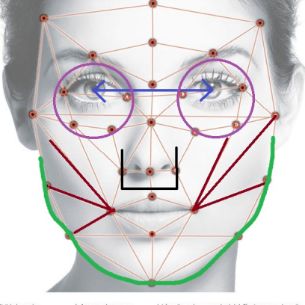
Here are few nodal points below :
Distance between the eyes
Width of the nose
Depth of eye sockets
Structure of the cheek bone
Length of jaw line

Slide 13
OBJECTIVES:
Portable student attendance system.
More accurate.
Time saving.
No need to maintain several separate records and manual calculations.

Slide 14
WHAT CONTRIBUTION WOULD OUR PROJECT MAKE ?
Face Recognition is the most natural biological features technology
According to cognitive rule of human beings , its algorithm is 10 times more complex than fingerprint,
This system will do its work even if one is not in touch with it or forget about it.

Slide 15
TEACHABLE MACHINE:
It is a web-based tool that makes creating machine learning models fast, easy, and accessible to everyone.
Teachable Machine web-tool helps to train a computer to recognize your own picture or images, music or sound.

Slide 16
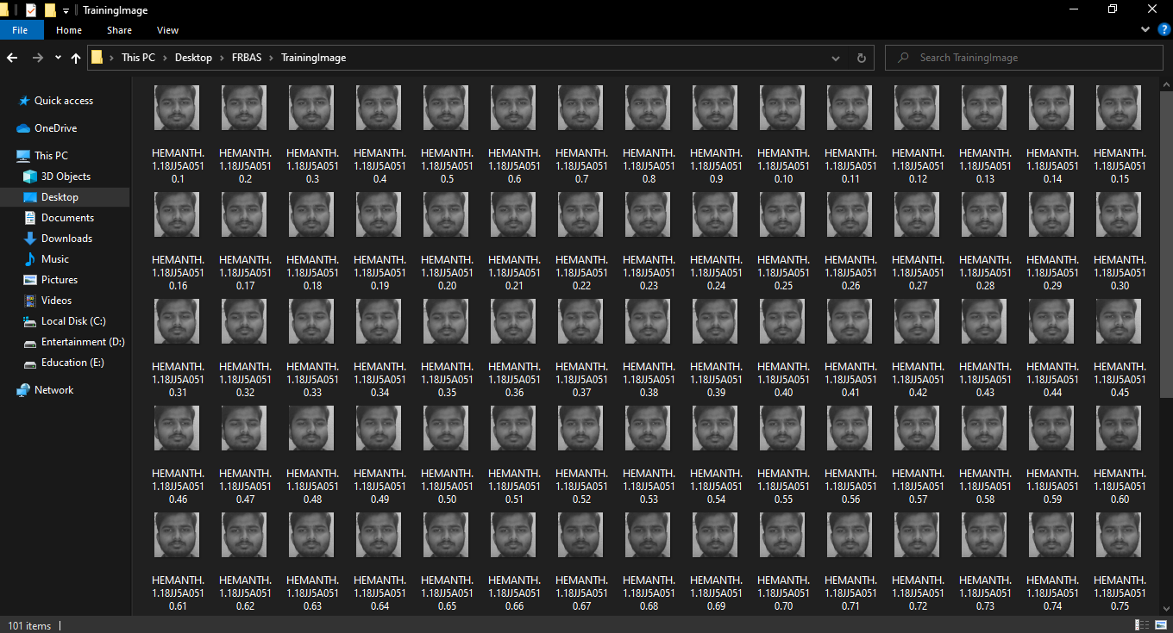
TRAIN A MODEL USING TEACHABLE MACHINE:

Slide 17
Principle:
The basic principle is that in each application there are three separate files that handle the three main pieces of logic separately:
Model defines the data structure. This is usually a database and is the base layer to an application.
View displays some or all of the data to the user with HTML and CSS.
Controller handles how the database and the view interact.

Slide 18
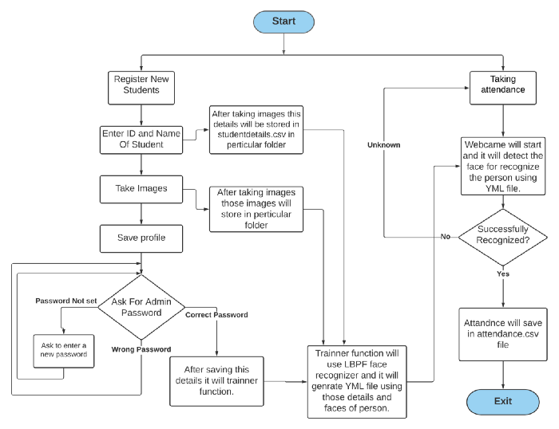
Flow diagram:

Slide 19
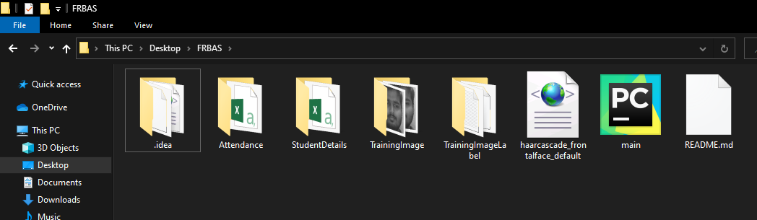
FILE STRUCTURE OF OUR SYSTEM

Slide 20
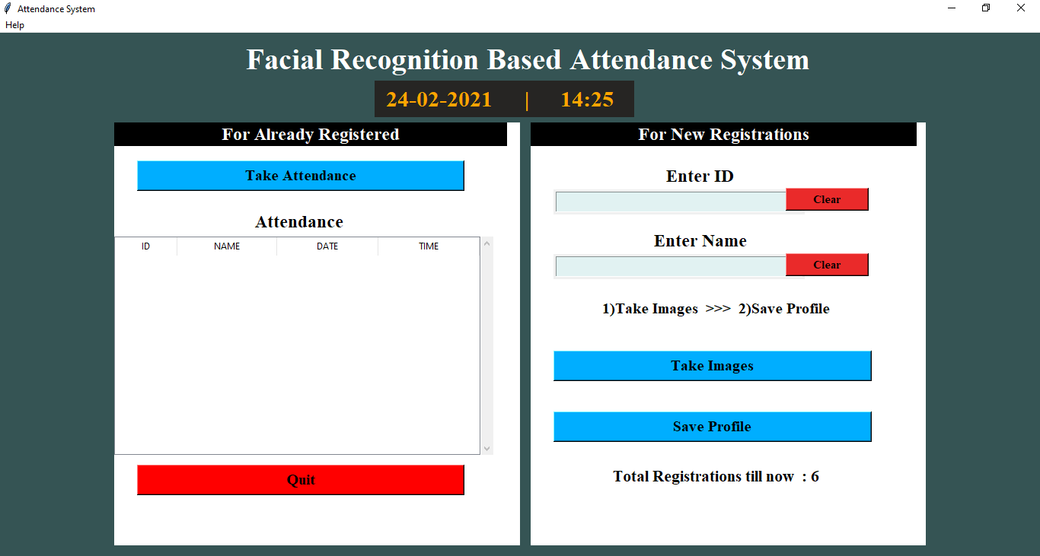
USER INTERFACE:

Slide 21
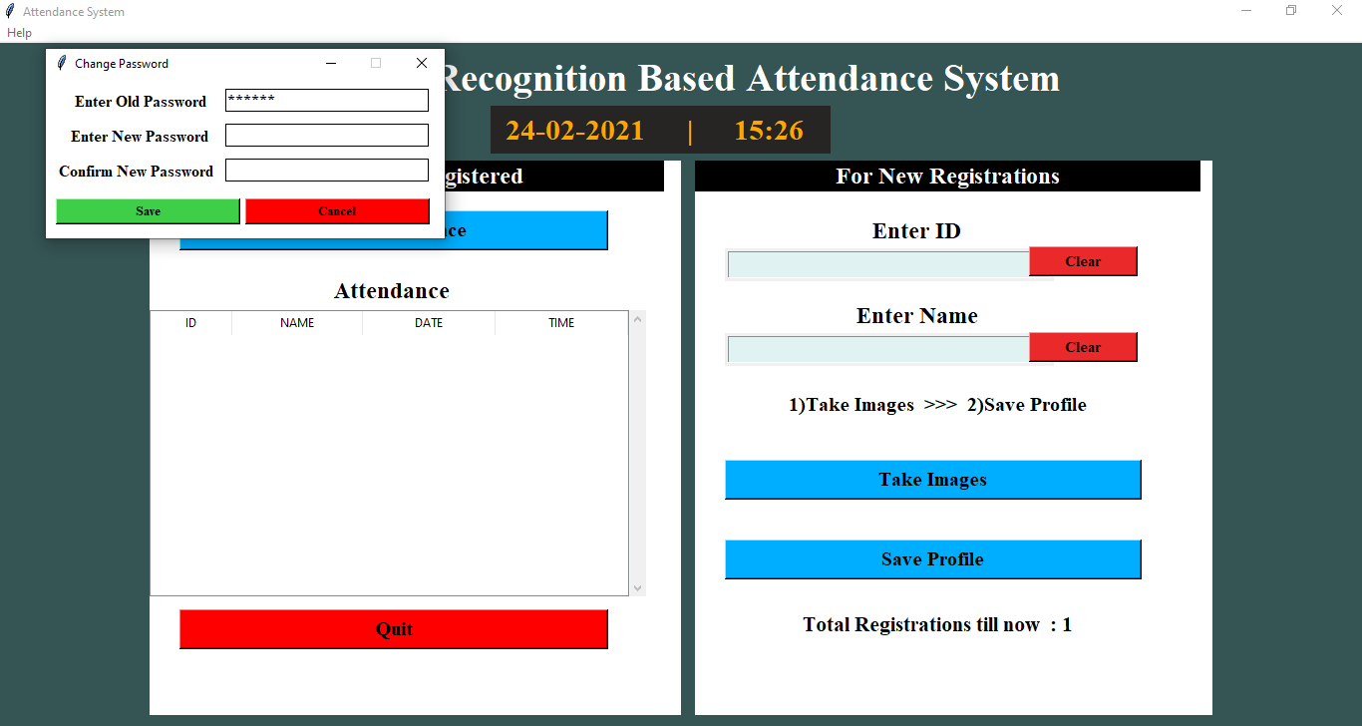
ADMIN MODULE:

Slide 22
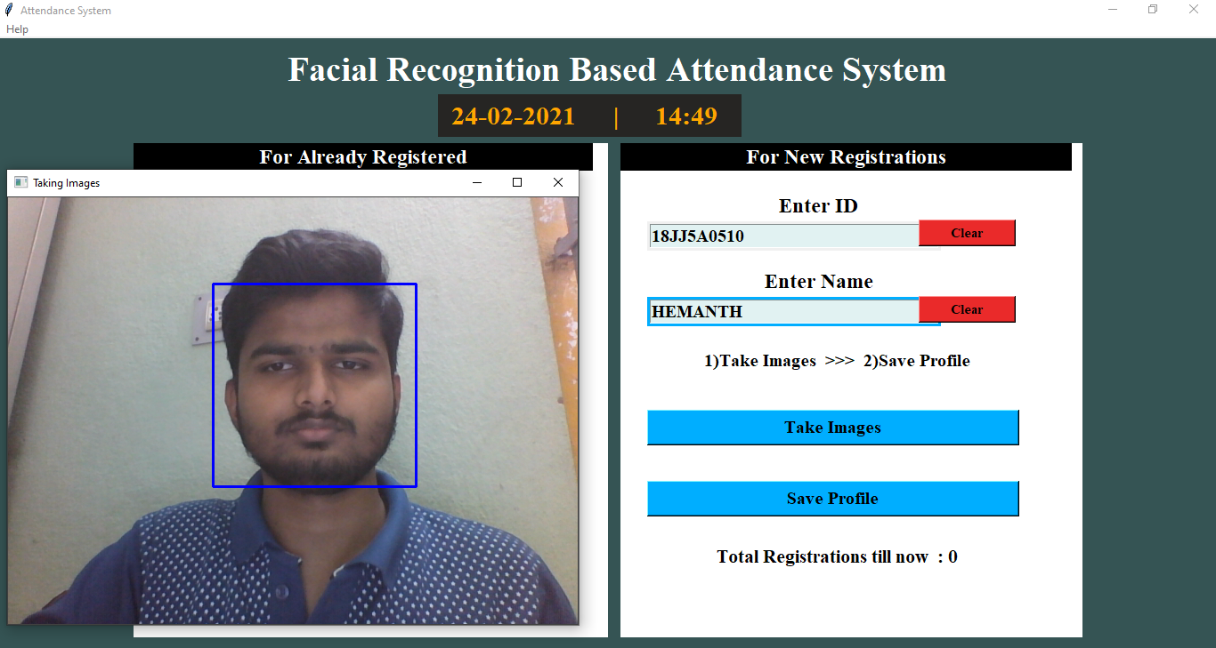
SAMPLE EXAMPLE:
Step 1: Training using Teachable machine.

Slide 23
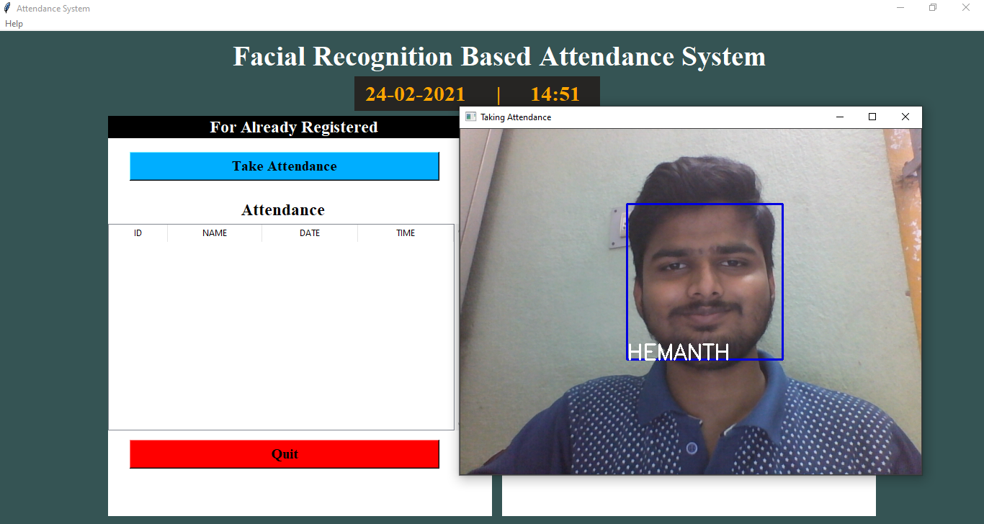
Attendance module
Step 2: Face Detection and Recognition.

Slide 24
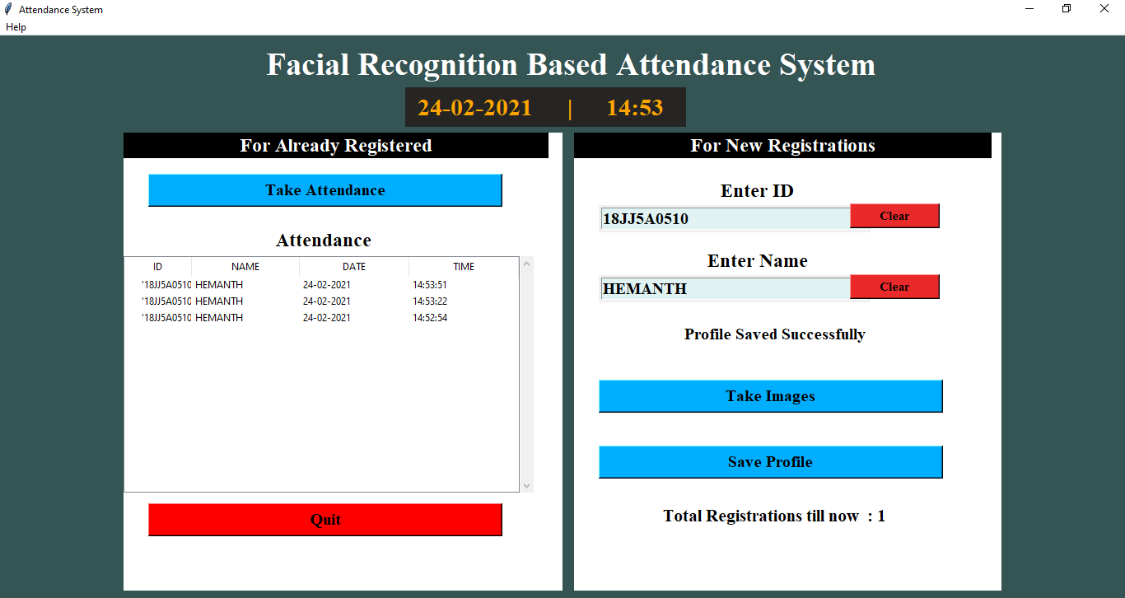
Attendance marked:
Step 3: Marking Attendance.

Slide 25
ADVANTAGES & APPLICATIONS:
Primary application being used in classrooms to take the attendance of students.
Maintains overall records.
Proxy attendance is eliminated.
Saves time.
Decreases false attendence and less mistakes.
Easy Integration.

Slide 26
CONCLUSION:
Proposed approach is simple in terms of calculation.
Improve speed of recognition.
Fast and convenient in identifying a person.
Crime detection.
Security use.

Slide 27
THANK YOU..!

